Slide 1
Microsoft Project 2007
Managing multiple projects

Slide 2

Course Objectives
Master, Sub Projects and Resource Pool
  Creating Master and Sub Projects
  Linking/Unlinking Master and Subprojects
  Creating Resource Pool & Sharing resources across projects
Exchanging information between project plans
  Linking task between different projects
  Project Workspace

Slide 3
Master and Sub Projects
Master Project
  A project with subproject inserted within it
  A group of projects with individual project inserted with it
Sub Project
  A normal project file created to schedule part of bigger project
  A normal project file created to schedule an individual project
Why
  The project is getting very longer, break it into smaller more manageable project files
  The project is large and different section will be managed by different project managers
  There is a common resource pool getting shared among different projects
  You are managing a program and want to collate status of different projects at one place

Slide 4
Creating Master and Sub Projects
Master Project: Main project
  Working with multiple projects - Exercise.mpp
Sub Project: System Integration Testing to be managed by test Lead
  System Integration Testing.mpp
Inserting a Subproject into Master Project
  Open Master Project
  Switch to Gantt chart view
  Select the row under which subproject is to be inserted
  Click Insert→Project
  Select the sub project and click insert
  You can see the subproject as task in the master project

Slide 5
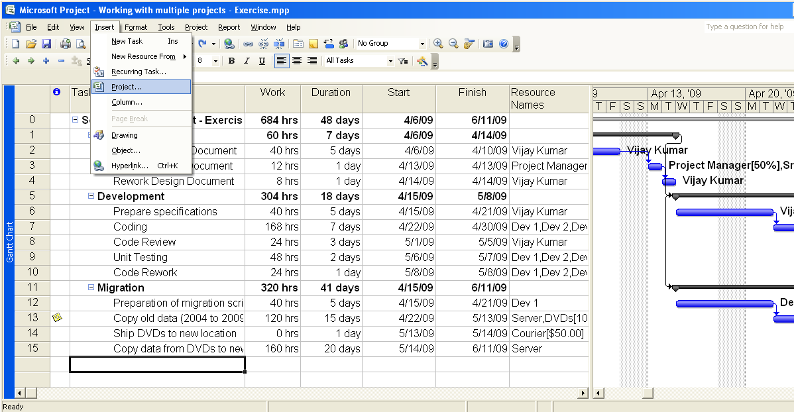
Linking Master and Sub Projects

Slide 6
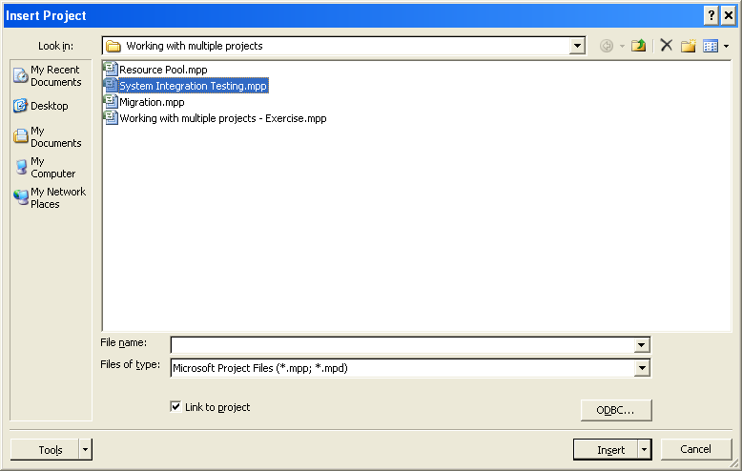
Linking Master and Sub Projects

Slide 7
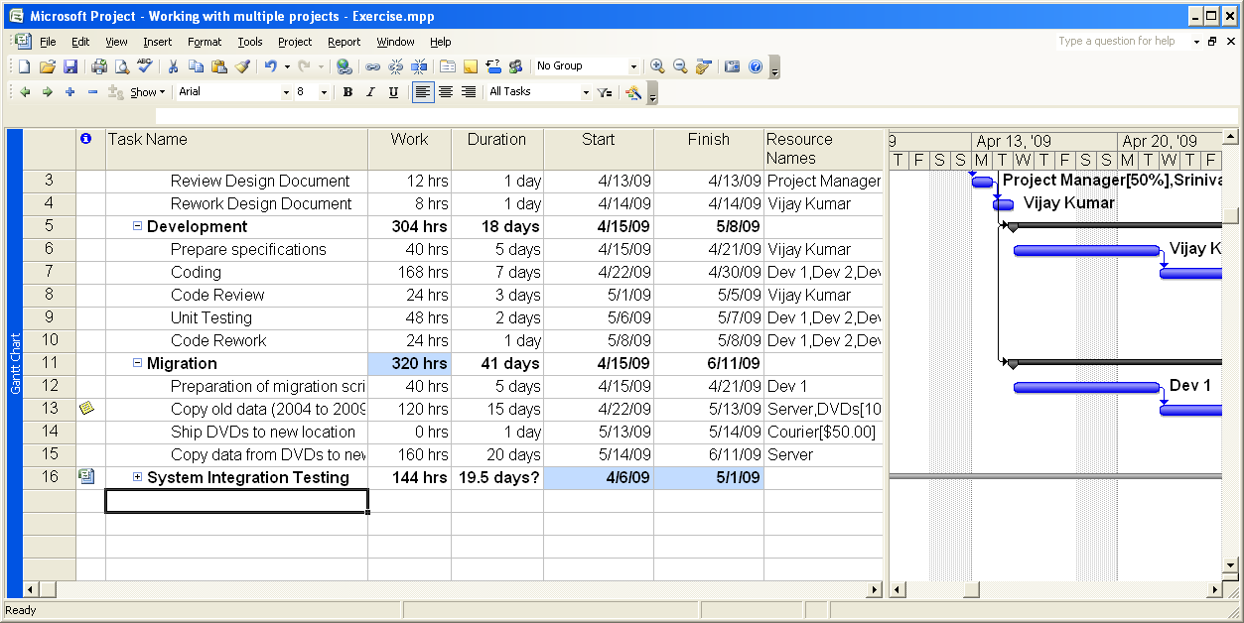
Linking Master and Sub Projects

Slide 8
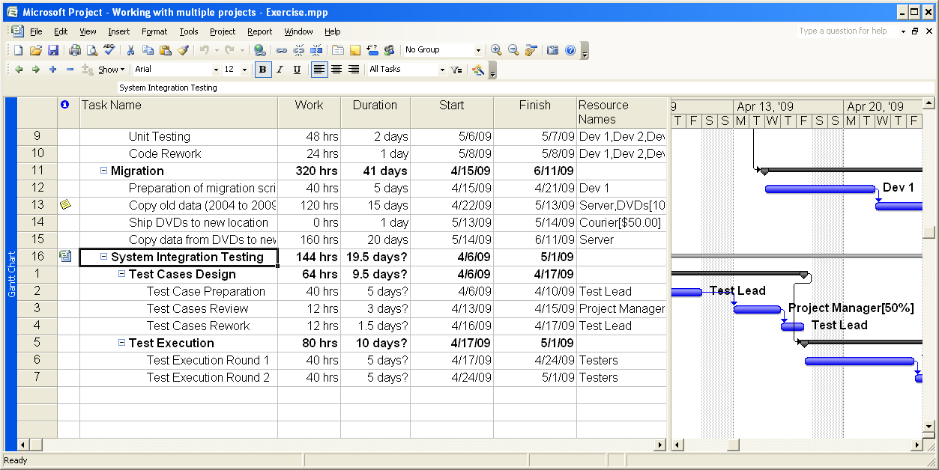
Linking Master and Sub Projects

Slide 9
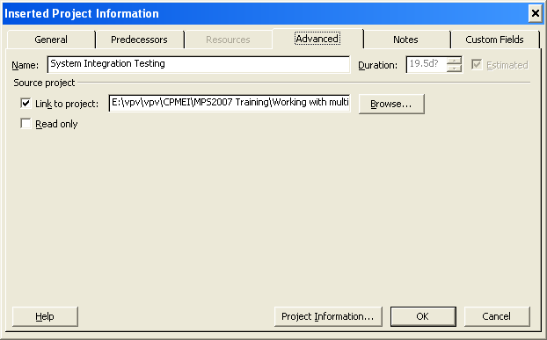
Unlinking Master and Sub Projects
Double click on Subproject summary task and uncheck the Link to project check box on Advance tab in Inserted Project Information dialog box
If both the project files are open and you have opened Subproject file first, you can make changes to subproject in the master project.

Slide 10
Keep subproject information Read-Only in Master Project
Double click on Subproject summary task and Click Read Only check box on Advance tab in Inserted Project Information dialog box
If both the project files are open and you have opened Subproject file first, you can make changes to subproject in the master project.

Slide 11
View Project Information of a subproject
Double click on Subproject summary task and Click Project Information... on Advance tab in Inserted Project Information dialog box

Slide 12
Creating Resource Pool
Open a new project file and switch to Resource Sheet view
Create a list of resources
Include information for all kind of resources i.e. work, material and cost
If you have list of resource available in any file, you can copy paste this information reducing your data entry efforts.
When copy pasting, select the complete resource information row not just the name
This is your resource pool
Save this file to a location that is accessible to project managers managing projects among which you want to share resource pool

Slide 13
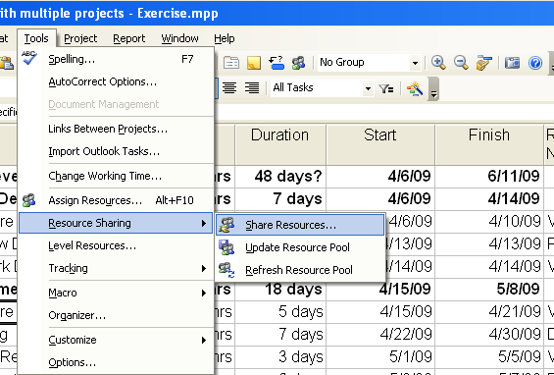
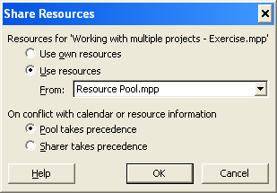
Using the Resource Pool
Open your resource pool file
Open the project where you want to use the resource pool
Select Tool → Resource Sharing → Share Resources
In Share Resource dialog box, select “Use Resource” option and select the name of resource pool file
Specify how the conflict is to be handled
All the resource listed in Resource Pool will now appear in your project file

Slide 14
Points to ponder
File containing resource list is called Resource Pool and file that is using resource pool is called Sharer
If Share Resources option is disabled, it means you are using enterprise setup and resource pool facility is not available. Use enterprise resource pool
If you close the resource pool file, you will find resource that are not used in sharer are disappeared from sharer If you open Resource Pool file without opening any Sharer file, you will be prompted with three options
  Open Resource Pool read only
  Open Resource Pool in read-write mode but do not allow update of resource pool through Sharer
  Open Resource Pool in read-write mode and allow update of resource pool through Sharer
If you open Sharer file without opening Resource Pool file, you will be prompted to open Resource Pool as well

Slide 15
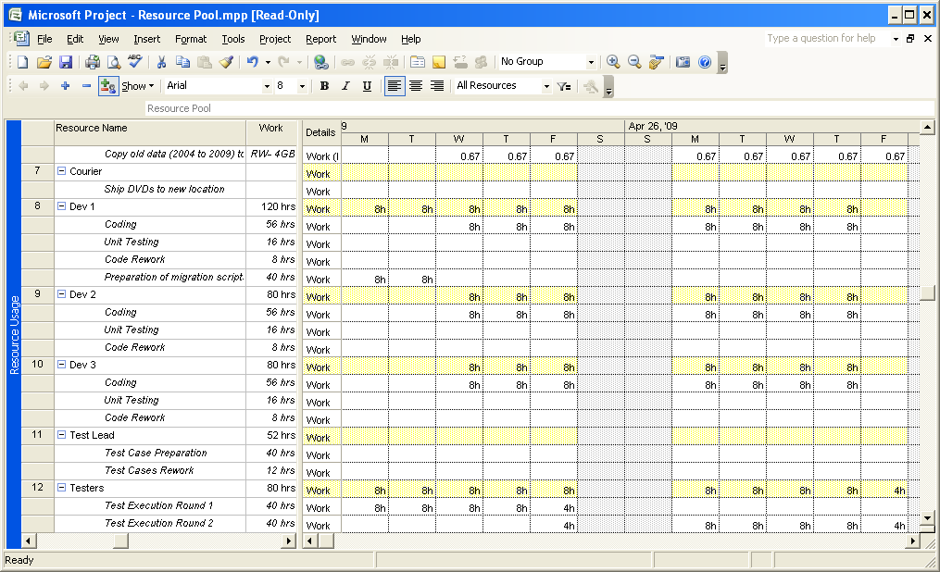
Resource availability, usages in Resource Pool
Which task has come from which project?

Slide 16
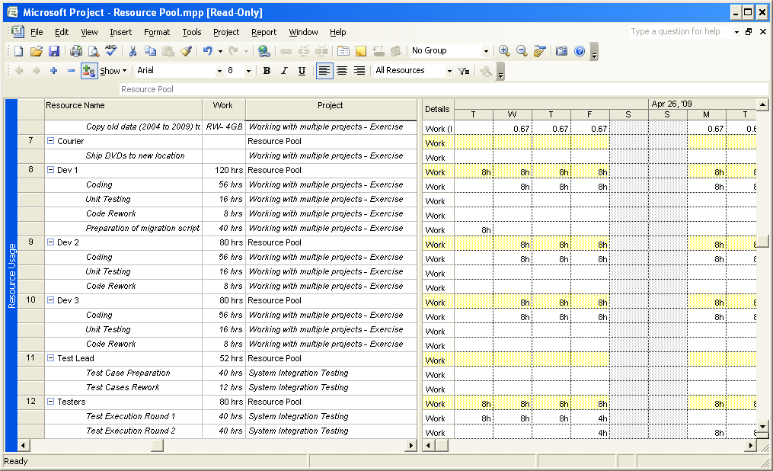
Resource availability, usages in Resource Pool

Slide 17
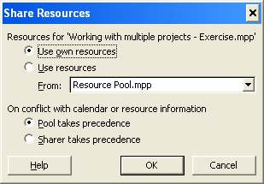
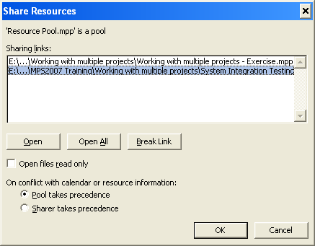
Disconnecting Resource Pool from Sharer
From Sharer
  Open both Resource Pool and Sharer files
  From Sharer, Select Tool→Resource Sharing→Share Resources
  Select “Use own resources"
From Resource Pool
  Open both Resource Pool and Sharer files
  From Sharer, Select Tool→Resource Sharing→Share Resources
  Select the file to be disconnected
  Click “Break Link”

Slide 18
Question

Slide 19

Course Objectives
Master, Sub Projects and Resource Pool
  Creating Master and Sub Projects
  Linking/Unlinking Master and Subprojects
  Creating Resource Pool & Sharing resources across projects
Exchanging information between project plans
  Linking task between different projects
  Project Workspace

Slide 20
Linking tasks across projects
You have multiple projects and a task in one project has dependency on a task in other project
If there is a master project, you can link these tasks like any other tasks in the project
If there is no master project consolidating these projects then?
Two methods to setup a dependency link between these tasks
  Use a temporary consolidated project
  Type the path of the task of one project into other project
Notes:
If there is a master project, task from different projects will be treated as tasks of master project and can be linked like any other tasks. Demonstrate this

Slide 21
Linking tasks across projects
Use a temporary consolidated project
  Open both the project
  Click Window → New Window
  You will be displayed all the open projects
  Select the project you want to link
  Select Gantt Chart in View and click OK
  A new project file will open consolidating both the project
  Link the successor with predecessor like any two tasks
  Close the new project without saving
  You can see link is setup in both the projects.
  You can observe dummy successor in the project having predecessor and a dummy predecessor in the project having successor
  You can observe gray bars against dummy tasks showing the link
Notes:
If there is a master project, task from different projects will be treated as tasks of master project and can be linked like any other tasks. Demonstrate this

Slide 22
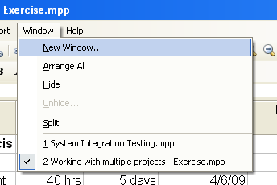
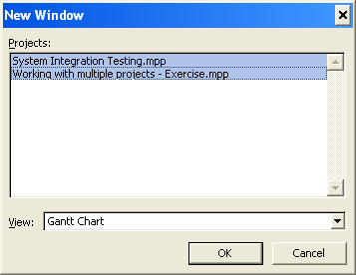
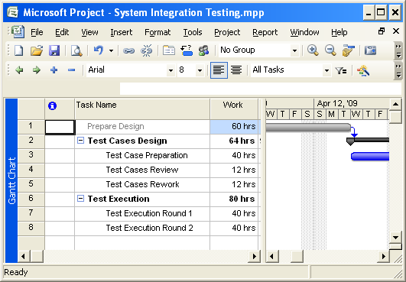
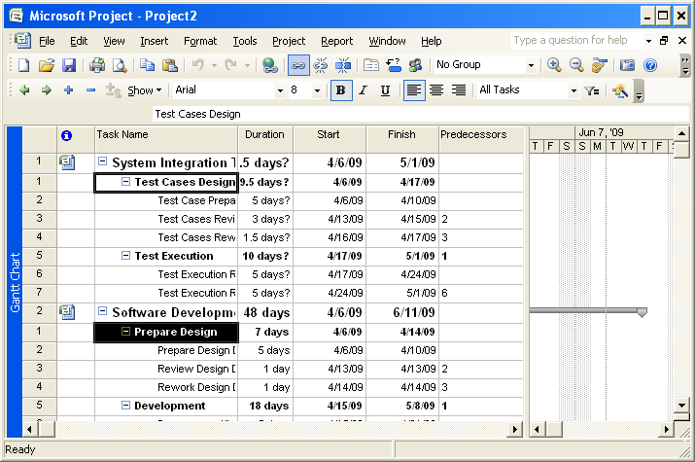
Linking tasks across projects
Notes:
If there is a master project, task from different projects will be treated as tasks of master project and can be linked like any other tasks. Demonstrate this

Slide 23
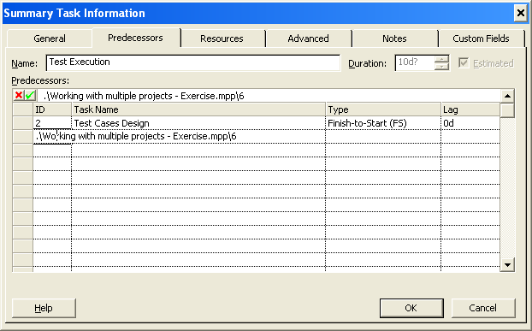
Linking tasks across projects
Specifying the path of the task
  Open a project and double click on the task to be linked
  Go to predecessor tab on Summary task information
  Type project filename with path followed by task Id of the predecessor
Notes:
If there is a master project, task from different projects will be treated as tasks of master project and can be linked like any other tasks. Demonstrate this

Slide 24
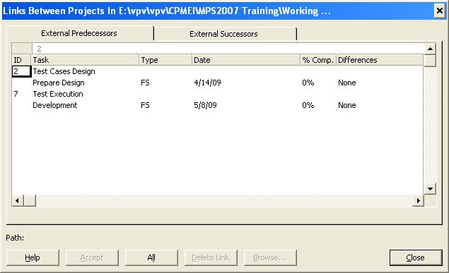
Review Cross Project Links
Click Tools → Links Between Projects
  This dialog box will appear every time you open the project file
If the linked task is changed since last time you open the project, the difference will appear here in this column
The accept button will get enabled and you can use it to incorporate the changes in the file. Without accepting, change will not reflect in the current file
Notes:
If there is a master project, task from different projects will be treated as tasks of master project and can be linked like any other tasks. Demonstrate this

Slide 25
Project Workspace
When sharing the information among projects, Project 2007 expects all projects to be open at same time
You can create a workspace that will help you to open all the project files together at one click
A workspace is a project file that consolidates project files you want to work together.
By Opening workspace, all the consolidated project files get opened together saving your efforts to open them separately
You can consolidate different projects and resource pool together in a workspace

Slide 26
Project Workspace
Change security setting for workspace
  Select Tools→ Options → Security Tab
  Change Legacy format option to “Allow loading files with legacy or non default file format”
Creating a workspace
  Open all the project files you want to be part of the workspace
  Close any file that you don’t want to be part of workspace
  Click File→ Same Workspace
  Give suitable name and save it at an appropriate location
  Your workspace is ready with .mpw ext. All the project files currently open are consolidated in the workspace.
  Now whenever you open the workspace, all the project files part of workspace will open at same time

Slide 27

Question

Slide 28
Course Objectives
Master, Sub Projects and Resource Pool
  Creating Master and Sub Projects
  Linking/Unlinking Master and Subprojects
  Creating Resource Pool & Sharing resources across projects
Exchanging information between project plans
  Linking task between different projects
  Project Workspace

